Slide 1
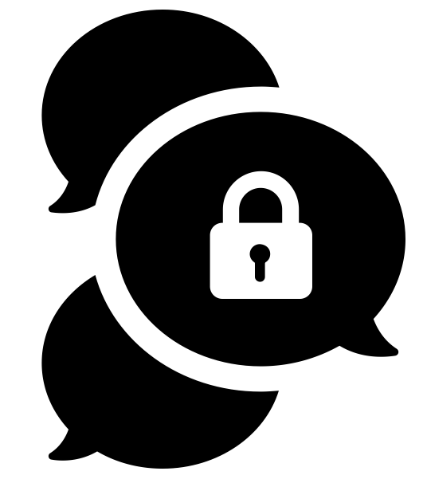


Taking a stand for privacy
#libstaff4privacy
by Gregor Cresnar from the Noun Project
by Gan Khoon Lay from the Noun Project
Created by Aude Charillon at Newcastle Libraries for the Carnegie UK Trust in April 2018.
Copyright in this presentation has been waived and content placed in the public domain (under CC0).
Content not under CC0 is credited on the slide it appears on.
Notes:
Welcome and introductions

Slide 2
For you, what is privacy?
Notes:
[Ask participants via Mentimeter - answer as a word cloud]
Highlight / comment results

Slide 3
privacy [noun]
1 A state in which one is not observed or disturbed by other people
1.1 The state of being free from public attention
Definition from Oxford Dictionaries
https://premium.oxforddictionaries.com/definition/english/privacy
Accessed 23/03/2018
Notes:
The dictionary definition

Slide 4
How does it fit with
the role of library staff?
Notes:
[Ask participants via Mentimeter – rating the proposed statements]

Slide 5
“Librarians have the understanding and expertise to
champion and promote openness and the public’s right to information;
oppose censorship and efforts to inhibit access to information;
select and make available information;
guide and support the public to seek, obtain and navigate
available information;
support the public to utilise and share this information;
facilitate intellectual and cultural creativity;
and safeguard the privacy of the public through ensuring data collation and surveillance are necessary, proportionate and lawful.”
Ambition & opportunity: a strategy for public libraries in Scotland 2015-2020. Strategic aim 5: Libraries promoting culture and creativity
Notes:
“It’s a requirement that we look into it”: Scottish libraries strategy + GDPR (more on that later)

Slide 6
In order for libraries to be safe and impartial spaces…
…we library staff have to
take a stand to protect citizens’ privacy.
Notes:
CILIP + IFLA
We can’t be neutral! If we don’t do anything to protect citizens’ privacy we’re actually siding with the opposite side.

Slide 7
How is your privacy affected online?
Notes:
How does the Internet / our smartphones work? At what point is our personal information collected, what is being collected, and by whom?

Slide 8
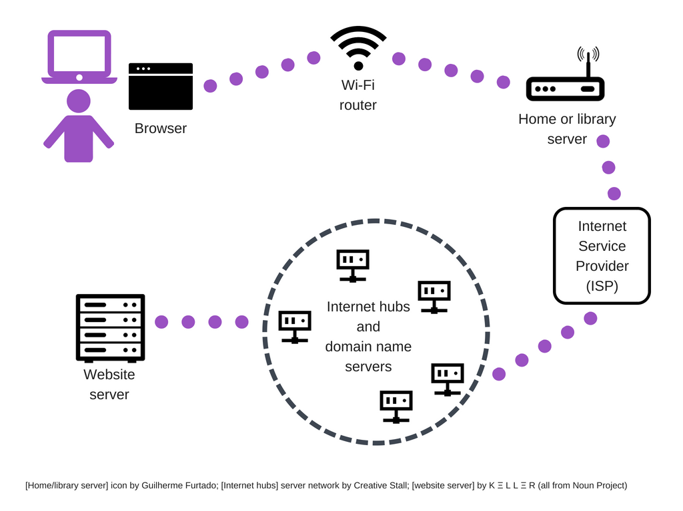
Notes:
How the Internet works
What data is collected from your browser (through “normal” working of systems + tracking elements)

Slide 9
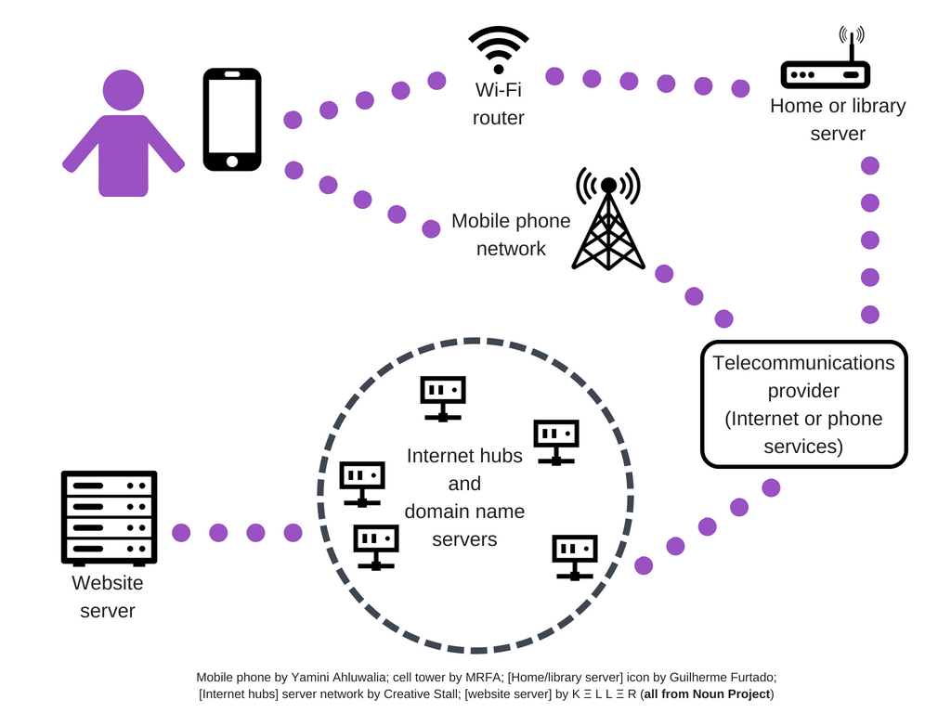
Notes:
How the Internet works – what’s the difference with your mobile phone?

Slide 10
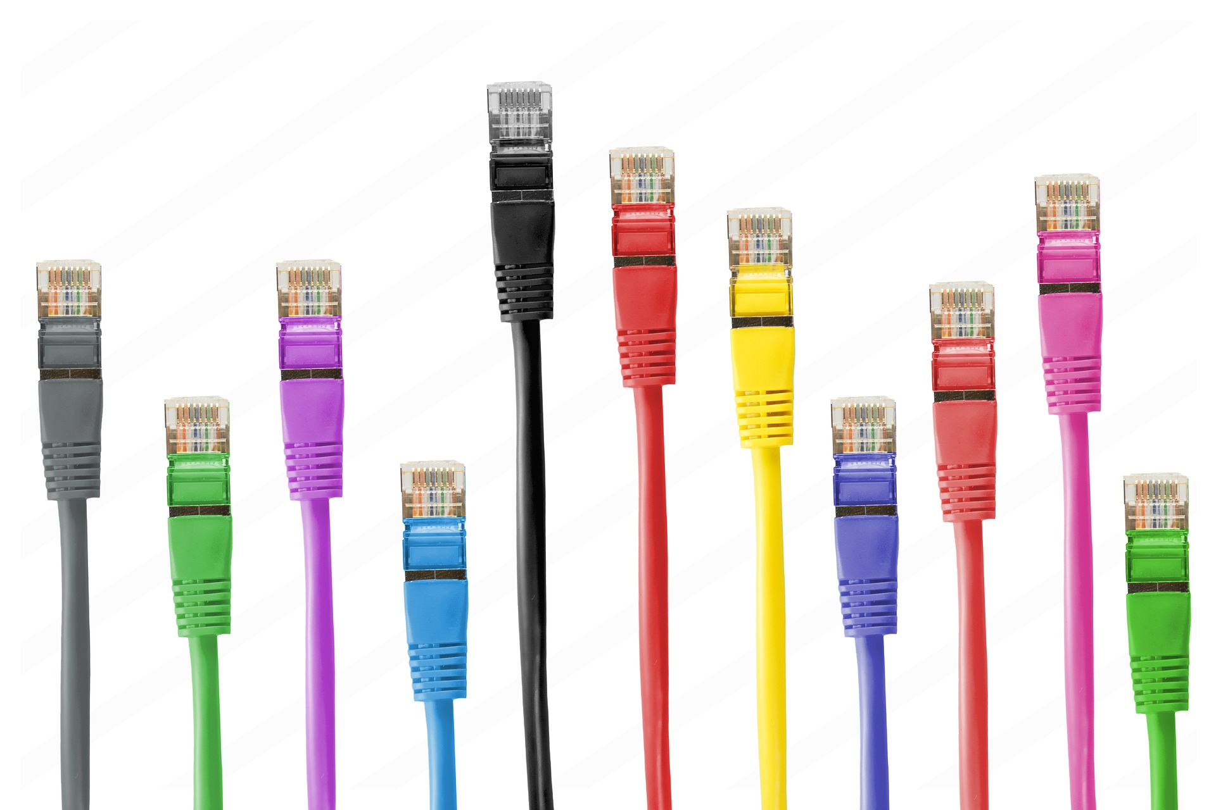
Notes:
What data is collected from your browser – demo Lightbeam (local news website, a national news site, tech news site, travel)
[Qs from Tactical Tech browser session] What is tracking? What type of data is being collected, and by whom? What do they / can they use it for?
[Pixabay free photo under CC0]

Slide 11
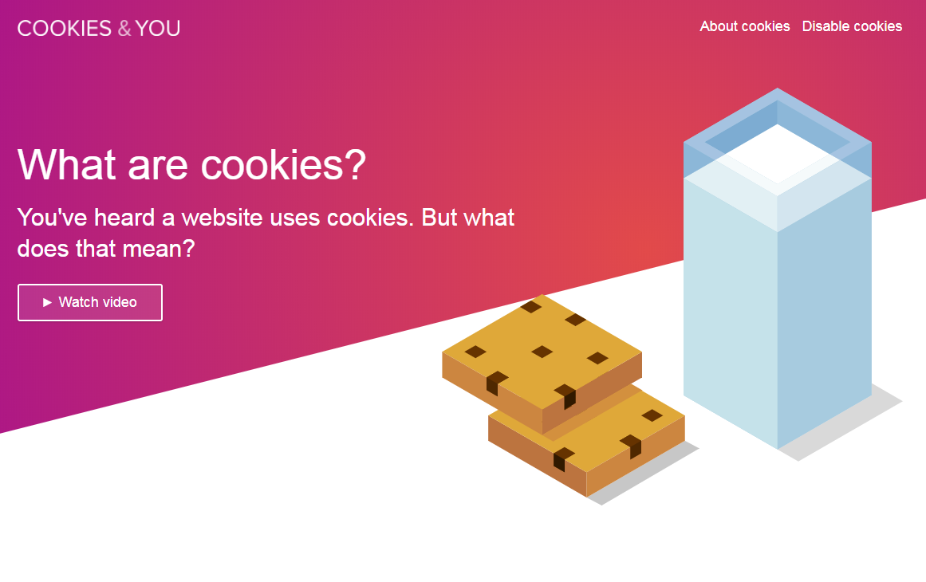
Notes:
Cookies explained quickly https://youtu.be/yoE9-tNvhRs
Screenshot from https://cookiesandyou.com/

Slide 12
What can you do about it?
Notes:
What are you most concerned about when you think about your digital privacy and security?
Assess risk: threat modelling
Then do something with tips and tools

Slide 13
Threat modelling
What information / data do you want to protect?
Who do you want to protect it from?
How likely is it that you will need to protect it?
How bad are the consequences if you fail?
How much trouble are you willing to go through in order to try to prevent those?
Notes:
Exercise for participants: with the person(s) sitting next to you, go through the questions as applied to you as an individual. (no more than 10min) (or if done individually: 5min)
Share /discuss some of your answers with the wider group (no more than 5-10min)

Slide 14
Threat modelling
in the library
What information / data do you want to protect?
Members’ personal info in the LMS and the OPAC
Who do you want to protect it from?
Malicious individuals; commercial interests
How likely is it that you will need to protect it?
Quite likely
How bad are the consequences if you fail?
Breach of legal duties = big fine, reputational damage
How much trouble are you willing to go through in order to try to prevent those?
Quite a bit, actually
Notes:
Example if needed (to be discussed in next section)

Slide 15

Notes:
Some tips and tools to protect your privacy online – talking about for us as individuals (for now)
Explain that protecting personal information online is linked to keeping information secure
[Pixabay free photo under CC0]

Slide 16
Passphrases
rather than passwords
The longer the passphrase the more difficult for a computer to crack it.
Words are easier for us humans to remember.
Make it random.
Notes:
Ask how many people re-use passwords + what the risk is
Explain passphrases and how to produce random ones (using a book + mention diceware)
Mention password managers

Slide 17

Big Browser is watching you!
Browser history
Private modes
Browser add-ons
Search engines
mask by Sergey Patutin
from the Noun Project
Notes:
Browser add-ons: Privacy Badger
Search engines: DuckDuckGo, Qwant
Show Chrome Incognito mode, Privacy Badger, search engines and Tor Browser on laptop (depending on time)

Slide 18


Install and try one of these tools:
compare it with what you normally use
Or clear your browser history and cookies;
try a private browser.
Notes:
Activity: have a go

Slide 19

Secure communications
thanks to encryption
HTTPS
Email encryption
Messaging services
Notes:
HTTPS Everywhere browser add-on
Show how to check website certificate
Email: mention PGP and Protonmail
Messaging: Signal

Slide 20
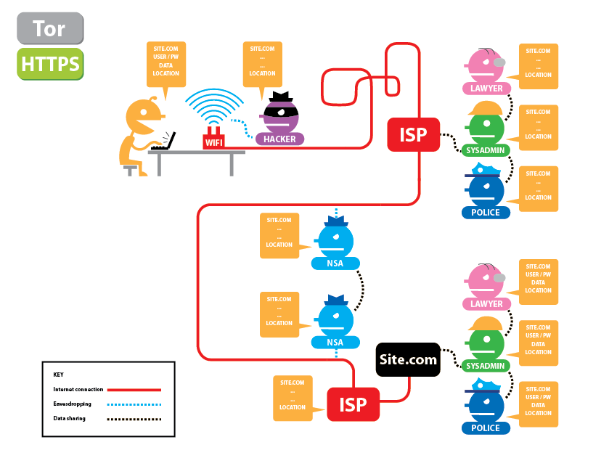
From Electronic Frontier Foundation
https://www.eff.org/pages/tor-and-https (cropped)
Used under a Creative Commons Attribution licence
Notes:
How the Internet works – with HTTPS

Slide 21
What can we do for citizens in libraries?
Notes:
Quick ideas (5min) (me to write things on flipchart): now you know a few things about how the Internet works, assessing risk and what to do about protecting personal information online, do you have any ideas of what we could do for citizens in libraries?

Slide 22

Transparency
Notes:
https://pixabay.com/en/ripped-paper-torn-through-broken-2034950/
Transparency
Telling citizens how we handle their personal information when they use library services
Comply with General Data Protection Regulation

Slide 23
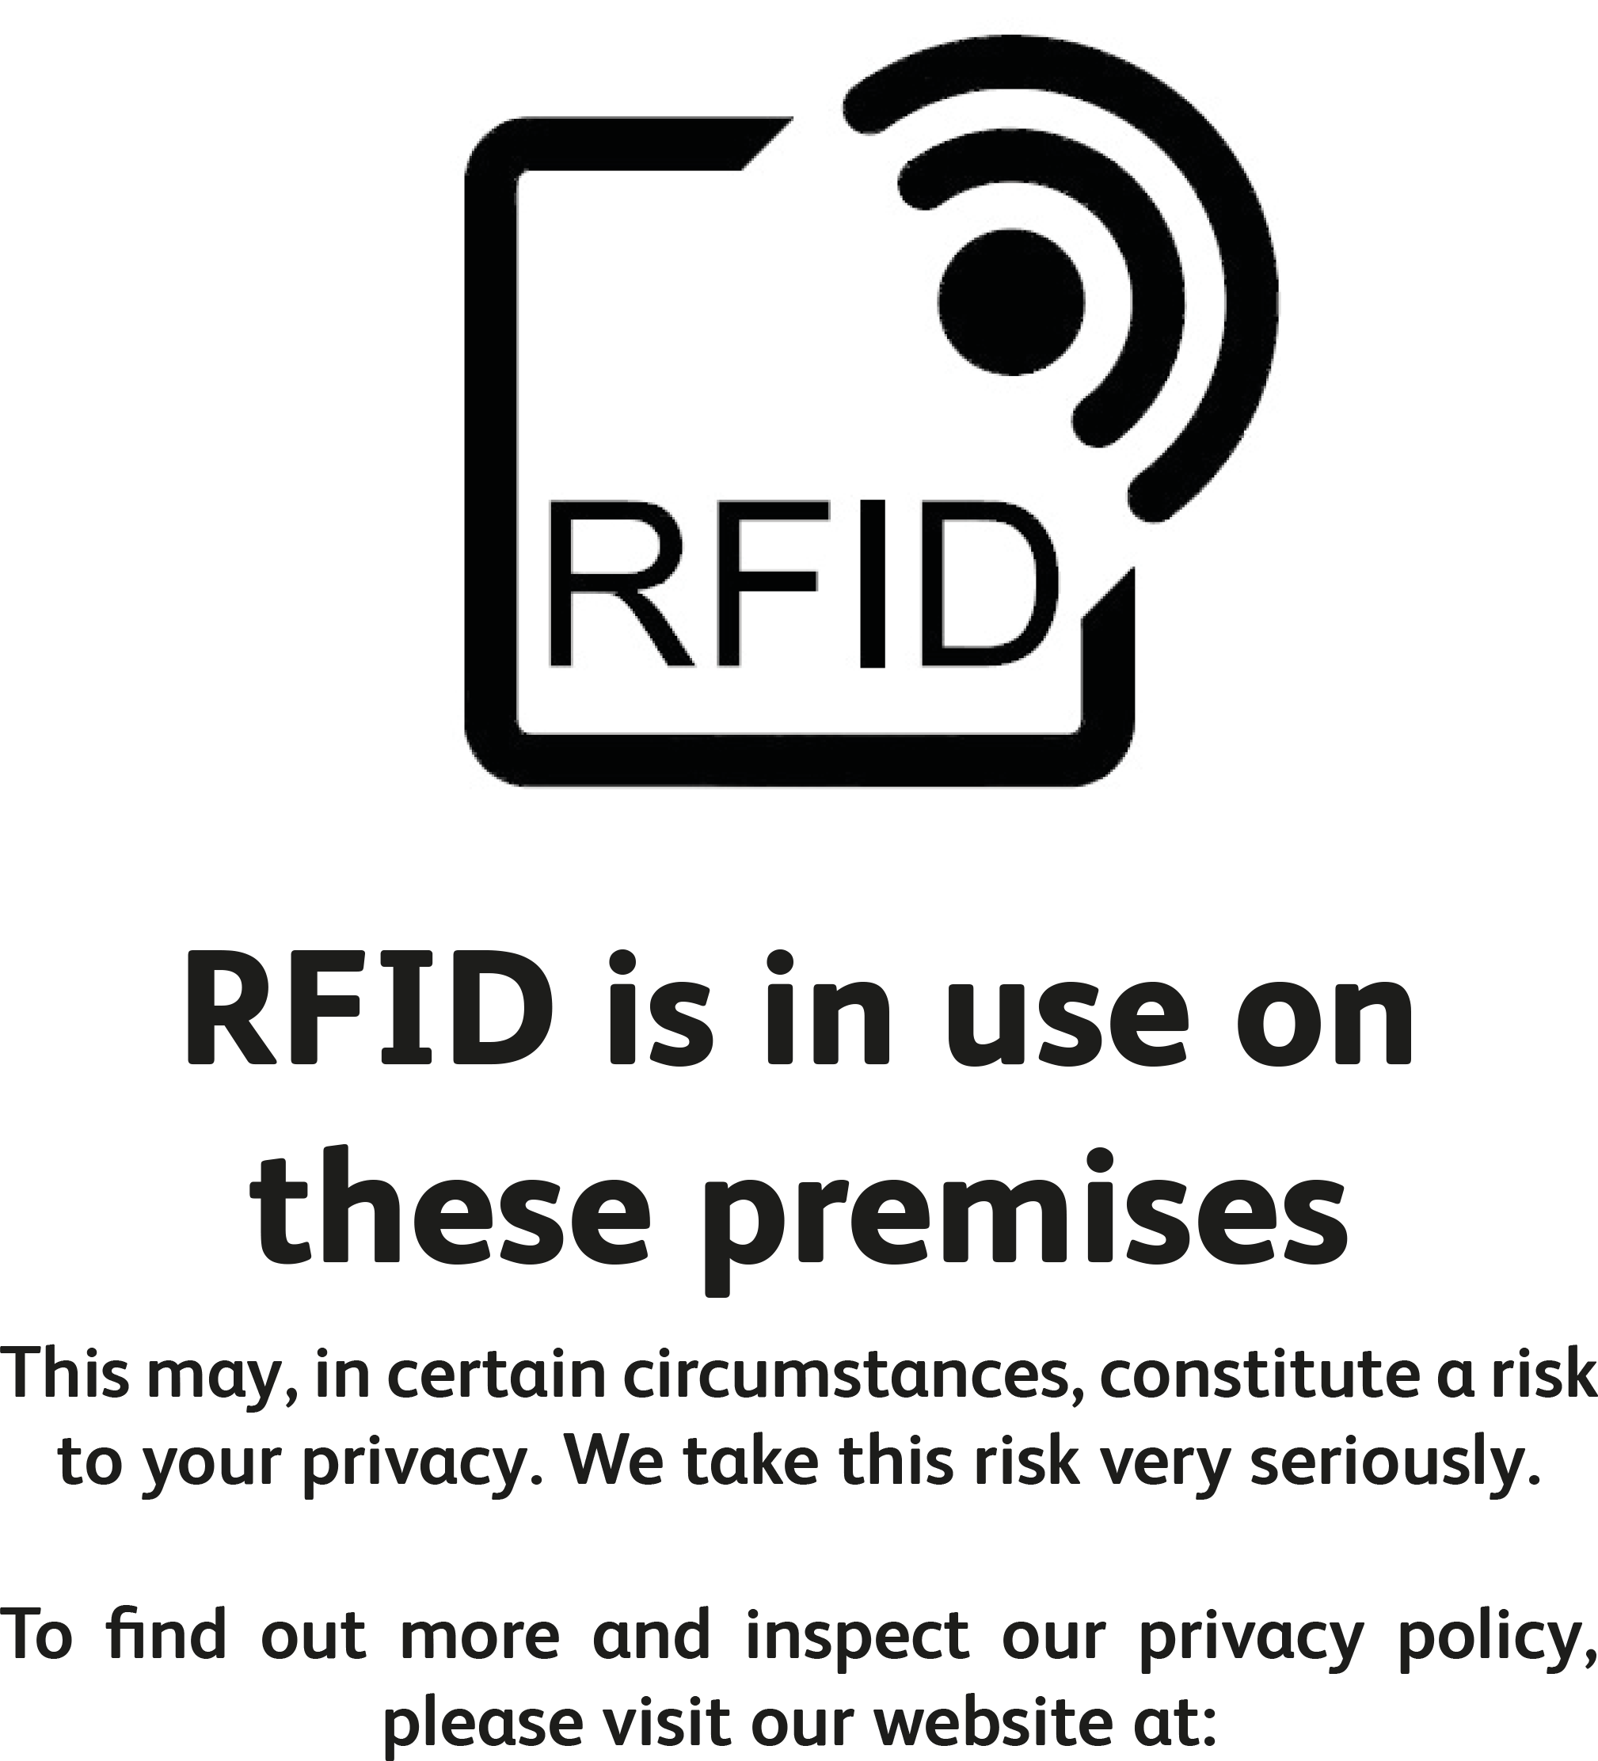
Screenshot from: BIC RFID privacy poster template - July 2017 http://www.bic.org.uk/161/RFID-Privacy-in-Libraries
Notes:
Example: RFID (BIC recommendations)

Slide 24
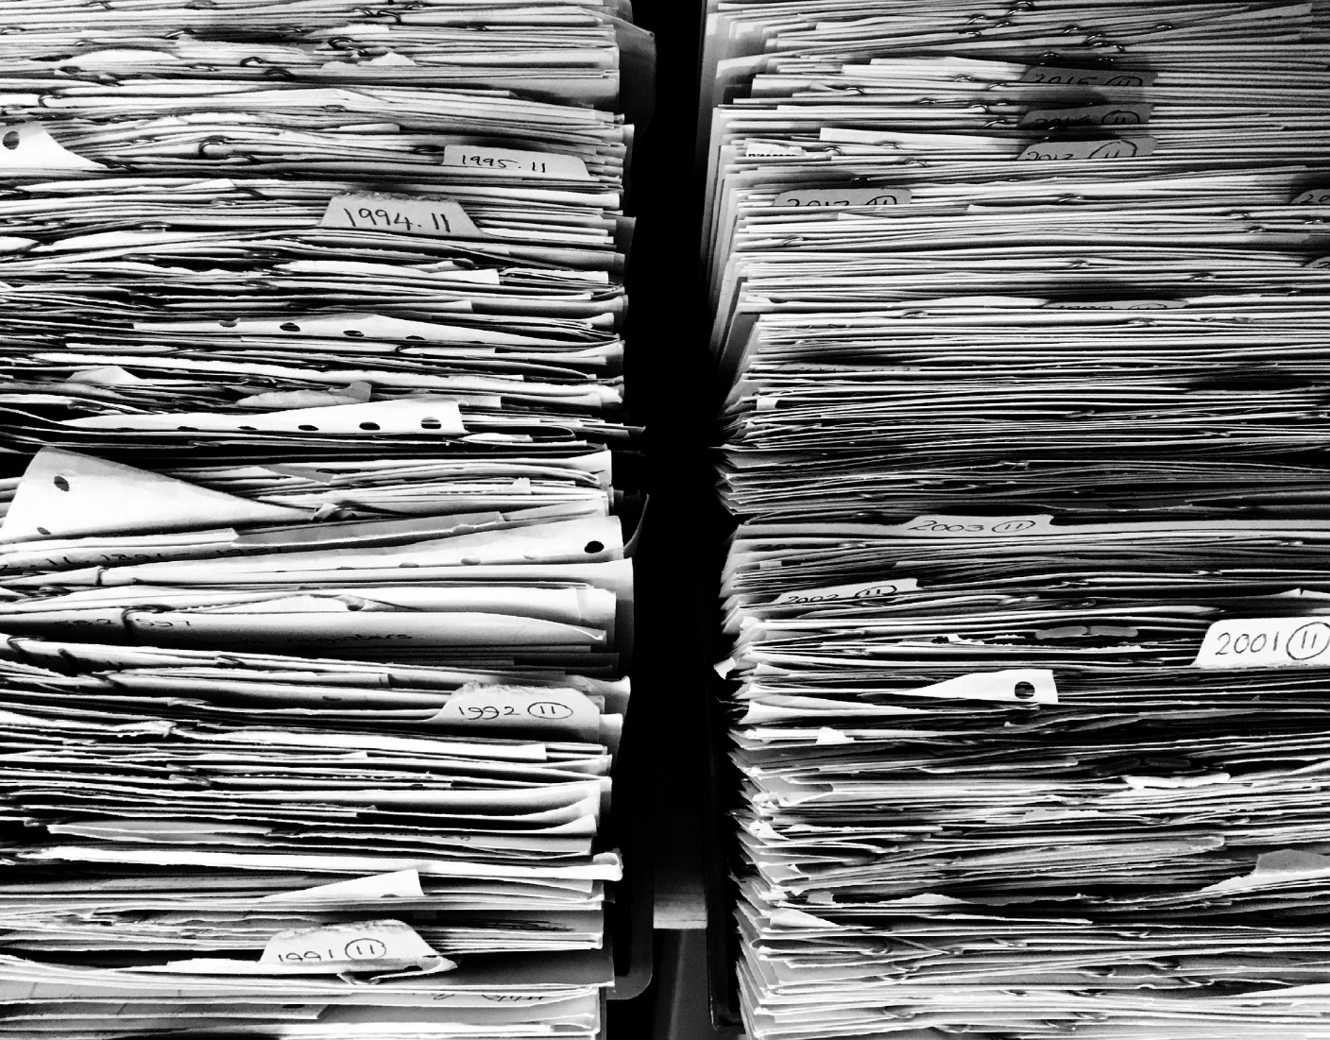
Notes:
Highlight all the things we keep about citizens who use libraries
[Pixabay free photo under CC0]

Slide 25
Data retention policies
computer usage logs
Internet browsing history on public computers;
files and other traces left by citizens on public computers;
Wi-Fi usage logs;
library members’ borrowing history;
library members’ reservation history;
library members’ payments history;
former library members’ details;
online catalogue / online library account usage logs;
website analytics;
events attendees list and personal registration details;
CCTV logs;
back-up databases and server logs.
Notes:
Talk about data retention

Slide 26
Threat modelling
in the library
What information / data do you want to protect?
Members’ personal info in the LMS and the OPAC
Who do you want to protect it from?
Malicious individuals; commercial interests
How likely is it that you will need to protect it?
Quite likely
How bad are the consequences if you fail?
Breach of legal duties = big fine, reputational damage
How much trouble are you willing to go through in order to try to prevent those?
Quite a bit, actually
Notes:
Comment

Slide 27
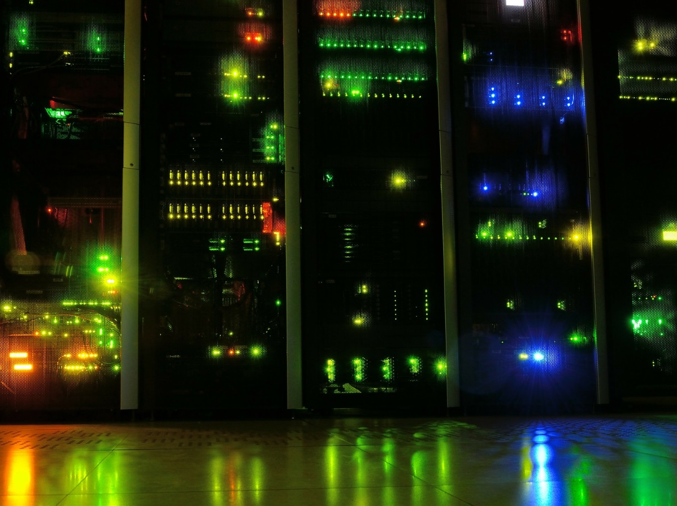
Notes:
Third-party suppliers
[Pixabay free photo under CC0]

Slide 28
“1. Data breach policy: is there a formal process in place to report data breaches if / when they occur?
2. Data encryption: if patron data is stored by the vendor, is it encrypted?
3. Data retention: does the vendor purge patron search history records on a regular basis?
4. TOS “ease of use”: can the average patron read and fully understand the vendor’s terms of use policy?
5. Patron privacy: does the vendor use Google Analytics or other tracking software to monitor users?
6. Secure connections: does the vendor’s website enforce secure connections only? (HTTPS or better?)
7. Advertising networks: does the vendor’s website participate in ad networks?”
Measuring library vendor cyber security: seven easy questions every librarian can ask by Alex Caro and Chris Markman. Published in Code{4}lib Journal, 2016 http://journal.code4lib.org/articles/11413 under a Creative Commons Attribution licence.
Notes:
Assess current systems

Slide 29
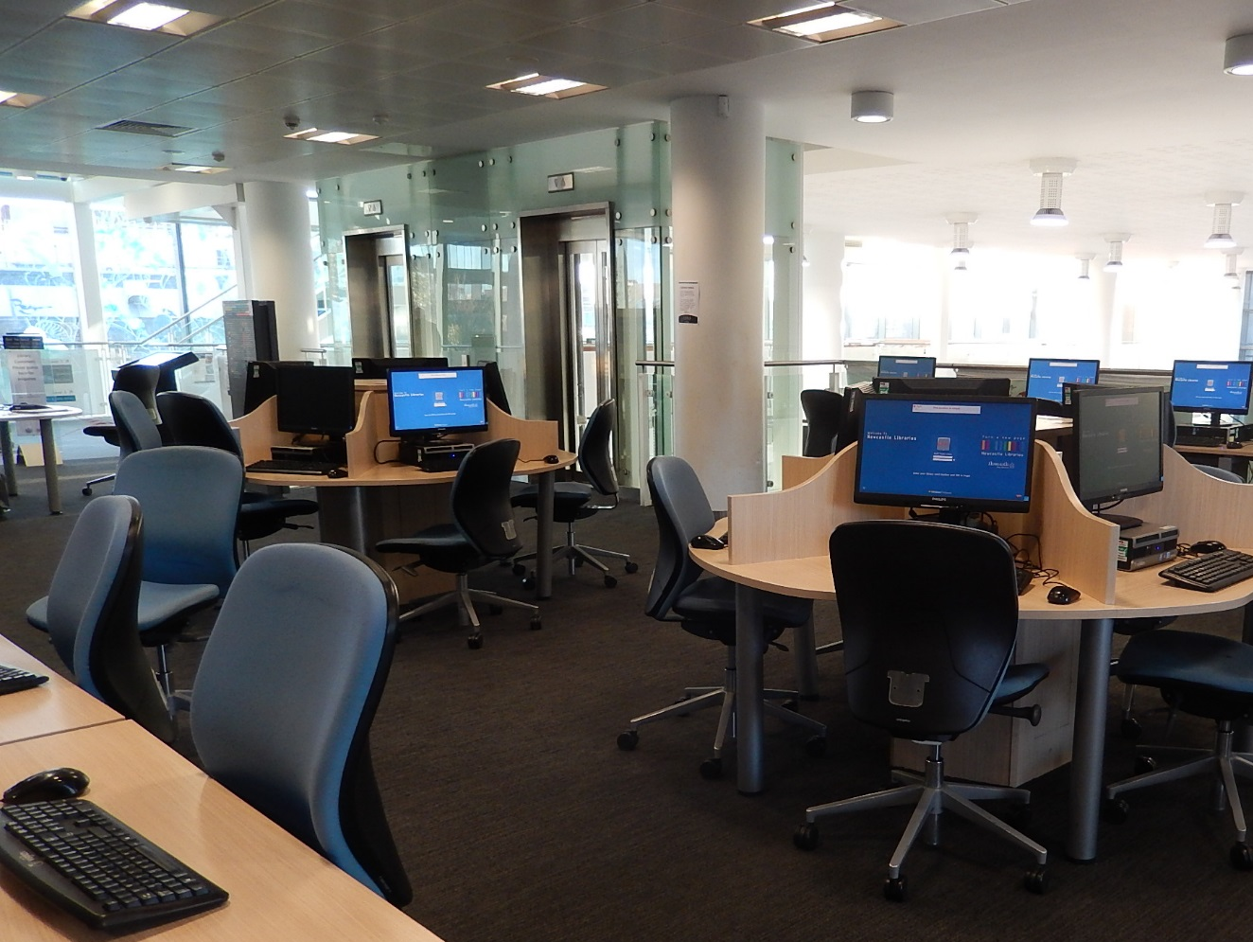
City Library (5 January 2017) – level 4 [cropped] by Newcastle Libraries (Source: Flickr)
Used under Creative Commons Attribution licence (CC BY 2.0)
Notes:
What about computers citizens use in libraries?
[City Library (5 January 2017) – level 4 by Newcastle Libraries; available under a Creative Commons Attribution licence https://www.flickr.com/photos/newcastlelibraries/31993204012/in/album-72157622716448663/]

Slide 30
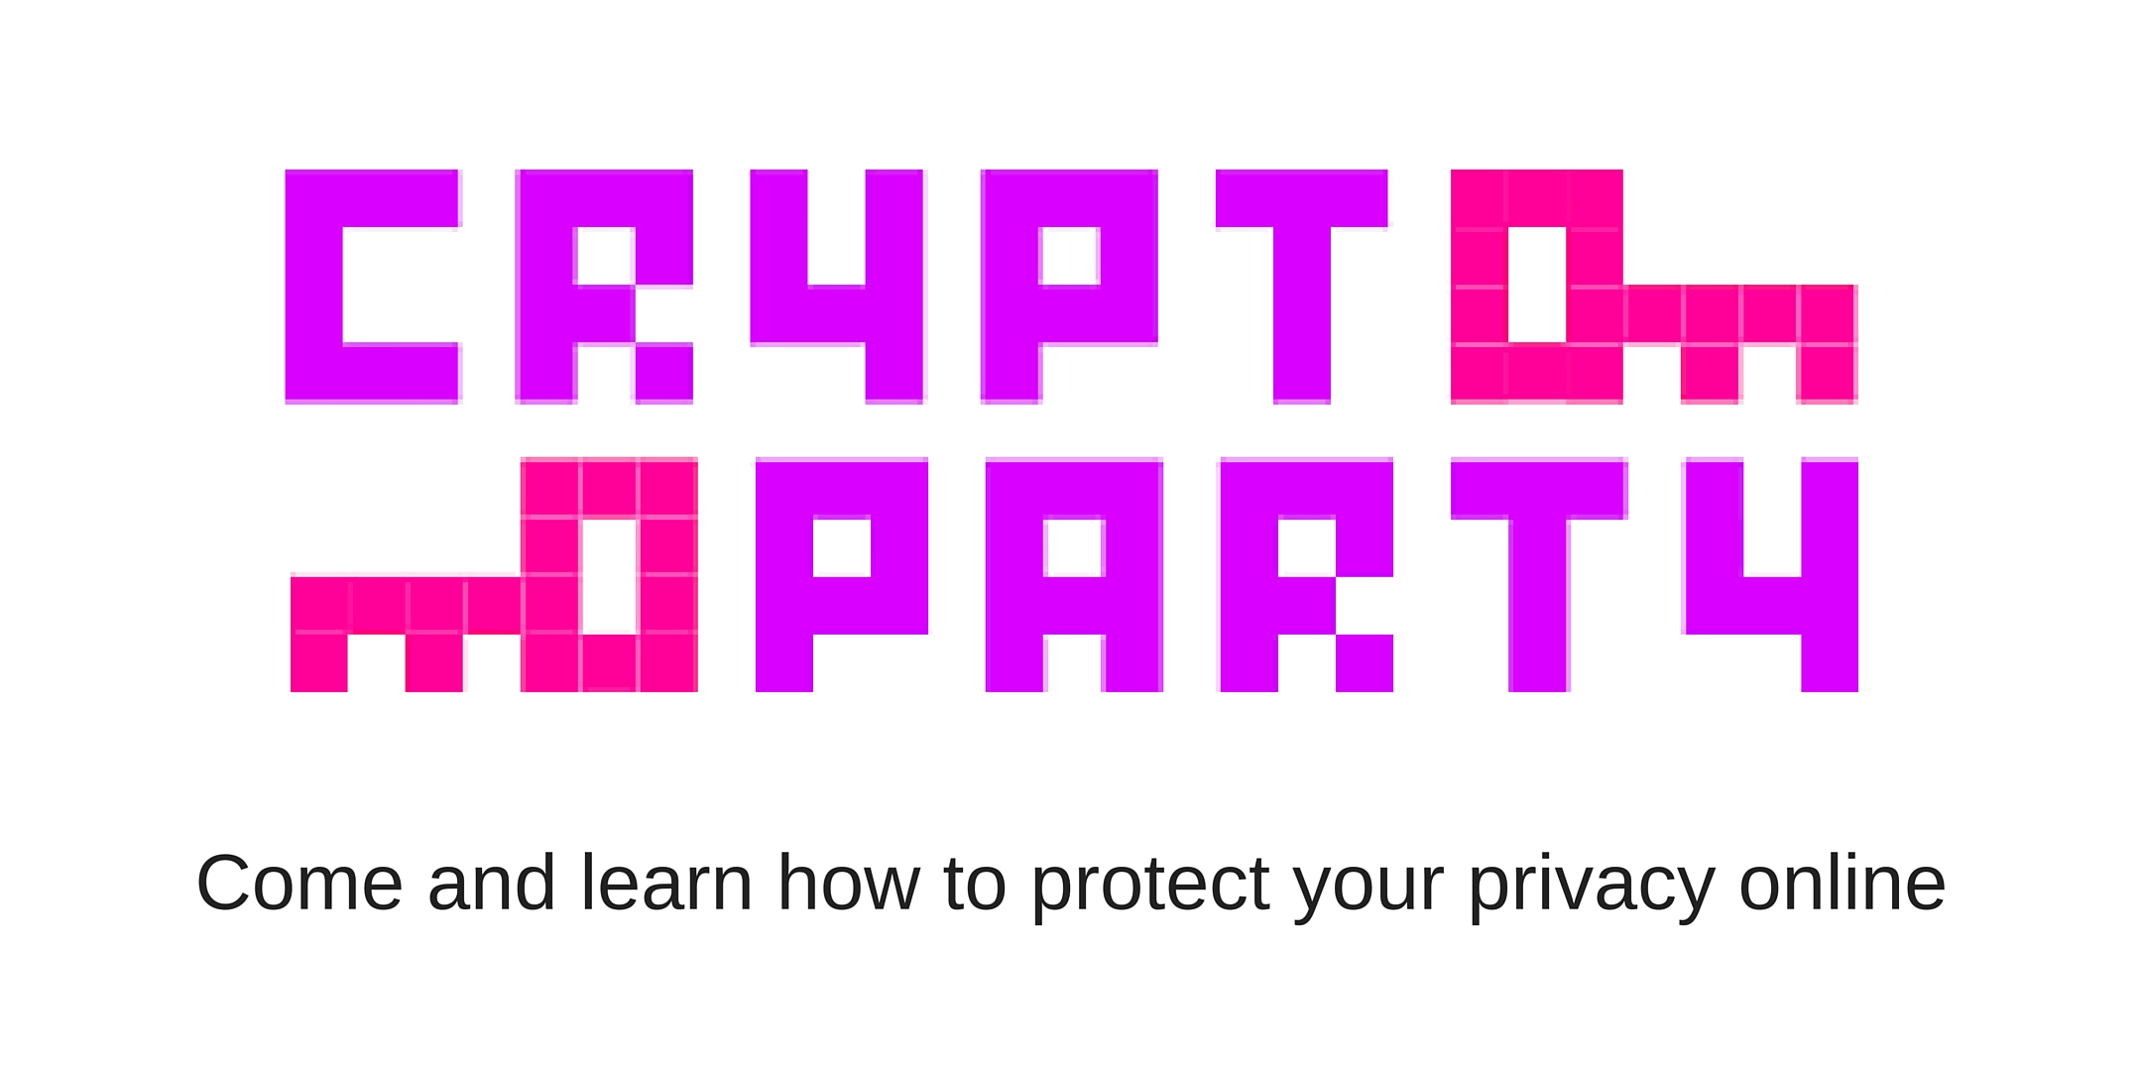
Notes:
Events for citizens: what kind? Who for? To cover what?

Slide 31
What next?
Notes:
Mentimeter: what is the first thing you will do (or would like to implement) when you get back to your library to better protect the privacy of citizens?

Slide 32

Notes:
Handout with links to resources
[Pixabay free photo under CC0]

Slide 33
Image left: by Gregor Cresnar; image right: by Gan Khoon Lay. Both from the Noun Project
Notes:
Conclusion

Slide 34
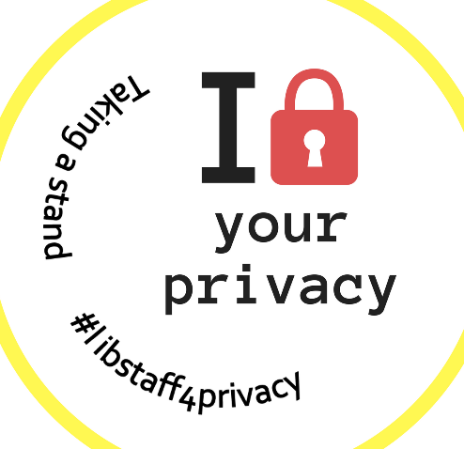
Taking a stand for privacy
Please get in touch!
aude.charillon@newcastle.gov.uk
@Audesome
#libstaff4privacy
Notes:
Keep in touch (if Twitter users: use the hashtag!)
Distribute badges

